Slide 1
Analysis of Climate Models
Caroline, Dario, Yoni

Slide 2
Climate models
Lay a finite grid over the globe
Try to model the main physical and chemical processes as best as possible.
Models are ~1 million lines of code, made up of interchangeable modules.
Modules are often reused, swapped around and shared within and between modelling groups/centers.
Not independent samples from “space of all models”!

Slide 3
Data: model output
Coupled Model Intercomparison Project (CMIP) Phase 5
Hosted on ETH Servers
In total: 17TB, temperature alone 3TB
But: Monthly data smaller (for temperature “only” 250GB)
Netcdf format

Slide 4
Model Uncertainty
3 kinds of uncertainties:
Model uncertainty: simulated physical processes are wrong*
Scenario uncertainty: Projected Carbon emissions are wrong*
Initial condition uncertainty: Initial conditions have error/might be missing.
Scenario uncertainty important for long-term, initial condition uncertainty for short-term, model uncertainty always important
Problem: How do we measure these uncertainties??
Takeaway: be wary of policy based on these model!

Slide 5
Model ensembles
Run different models under different scenarios, and combine their results.
Used to get “more robust” forecasts.
Fundamental dilemma: For most statistical inference, independence assumptions are used (i.e. confidence interval).
Problem: in lieu of interdependene, can we at least say how different these models are? How do we measure “distance” between models?

Slide 6
Our preliminary ideas
Define different metrics to measure distance between models
use euclidean distance
Use general principal component analysis to define weight matrix
Find a more sophisticated way of looking at inter-model distances (e.g. Tensor decomposition)
How do relationships between models change when we change scenarios or ensembles?
Find new ways of visualizing the data and performing EDA.
Problems for all approaches: Models are tuned to fit observations well (no organization wants to have an “outlier” model, even though this could prove useful)

Slide 7
Current challenges
No database that comprehensively describes all the models.
There appear to be some serious problems with the data internally.
Without ground-truth observations, there is no low-hanging fruit.

Slide 8
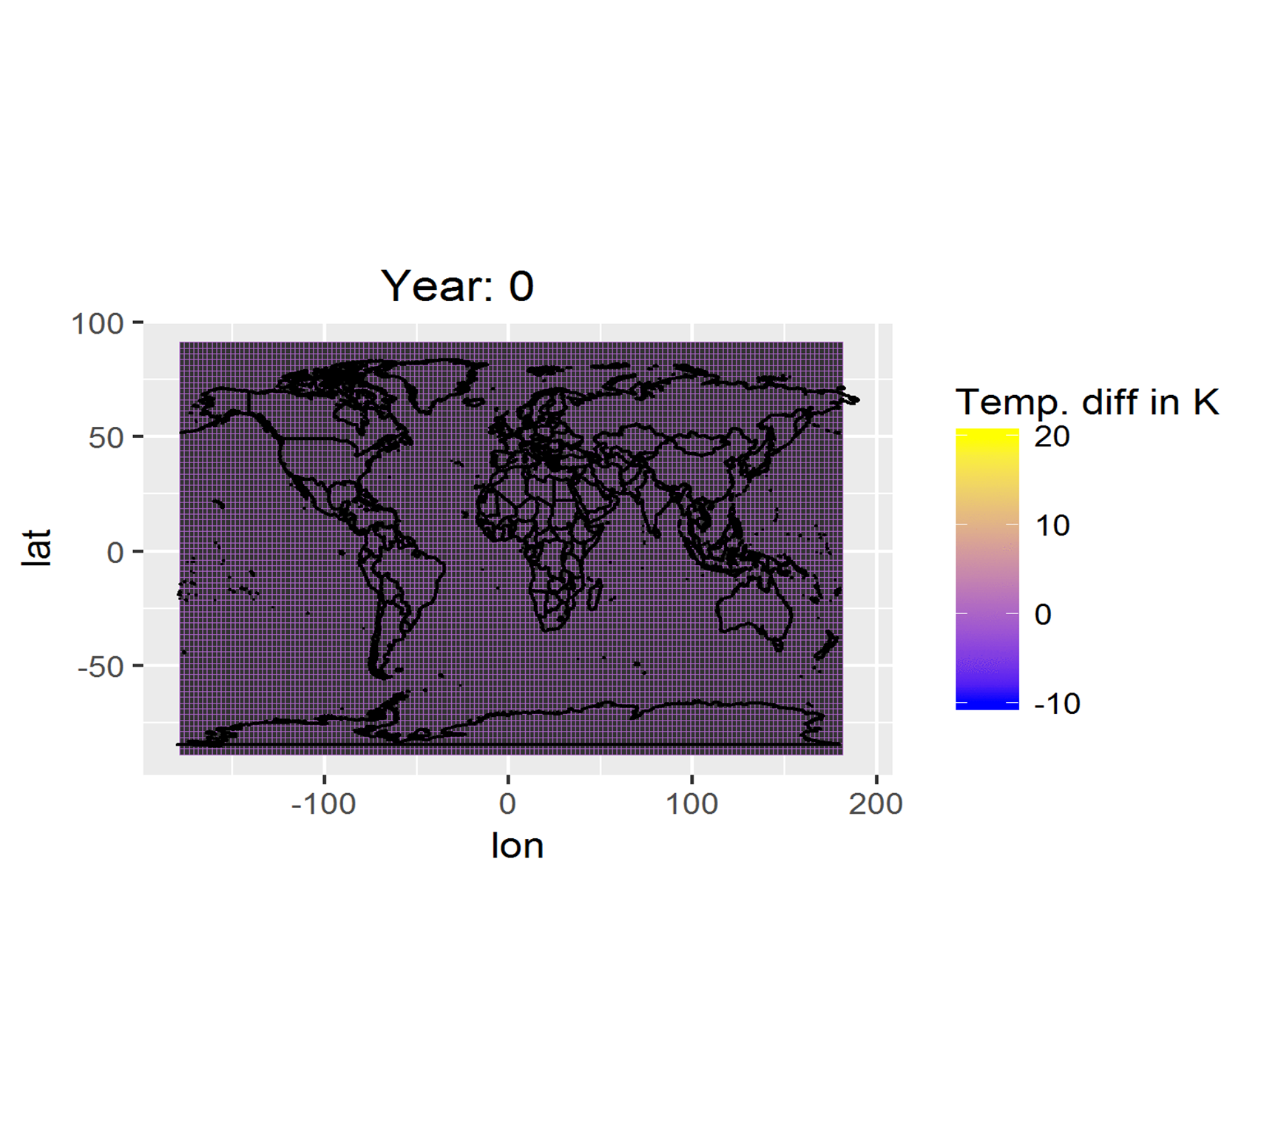
Exploratory Data Analysis

Slide 9
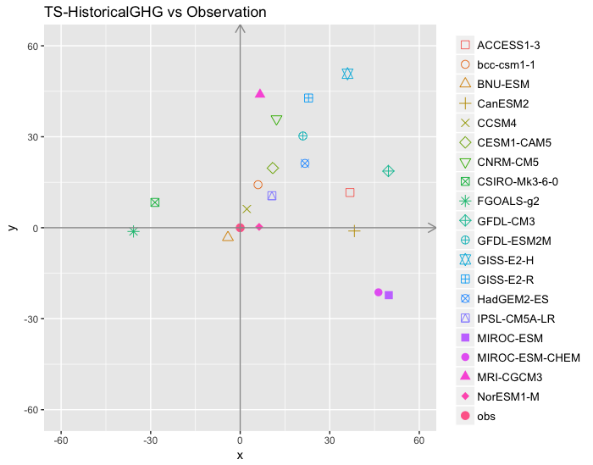
Multidimensional Scaling

Slide 10
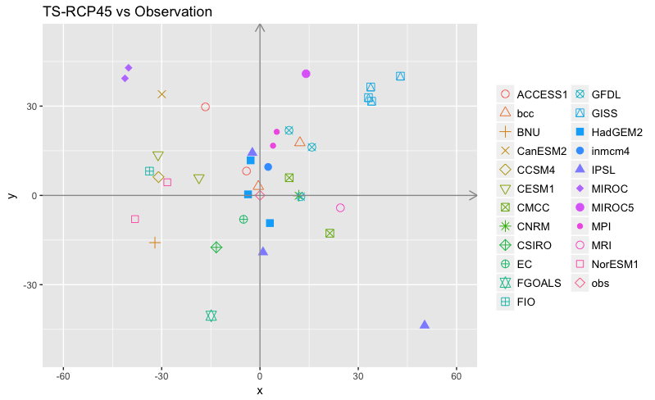
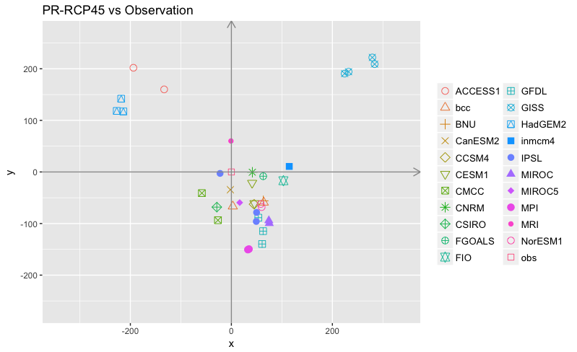

Slide 11
We have some tool tips for you!
(if you need them…)

Slide 12
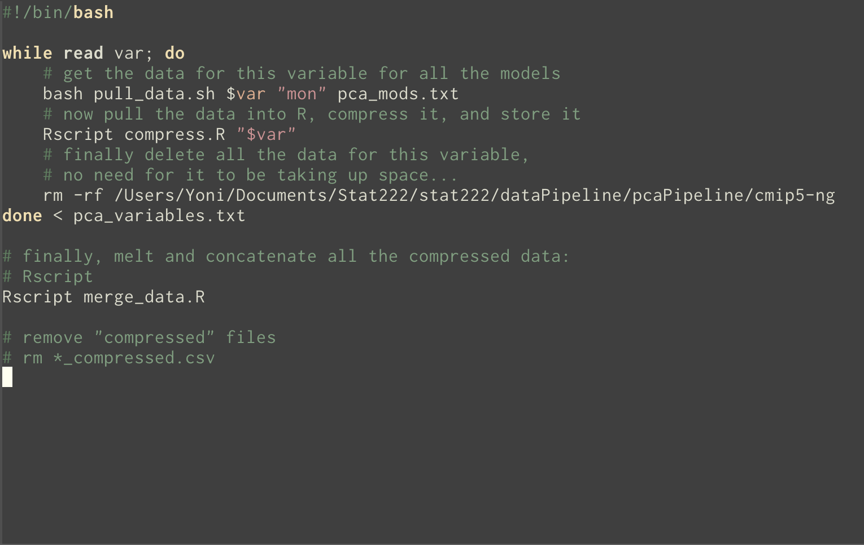

Slide 13
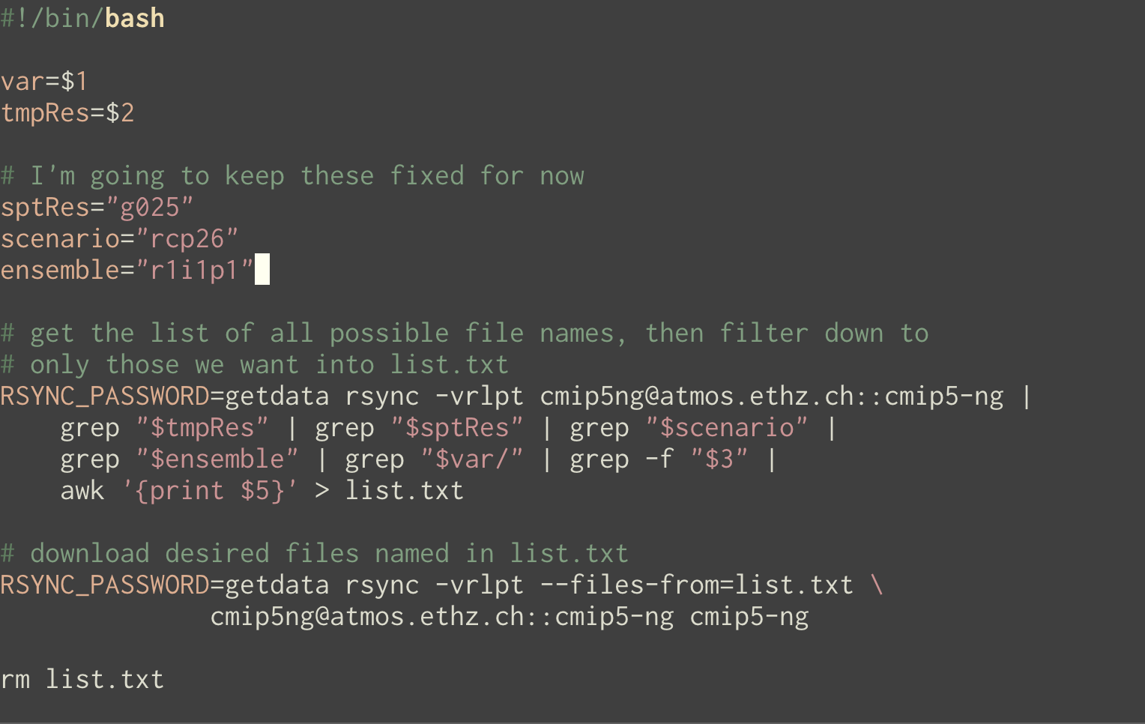

Slide 14
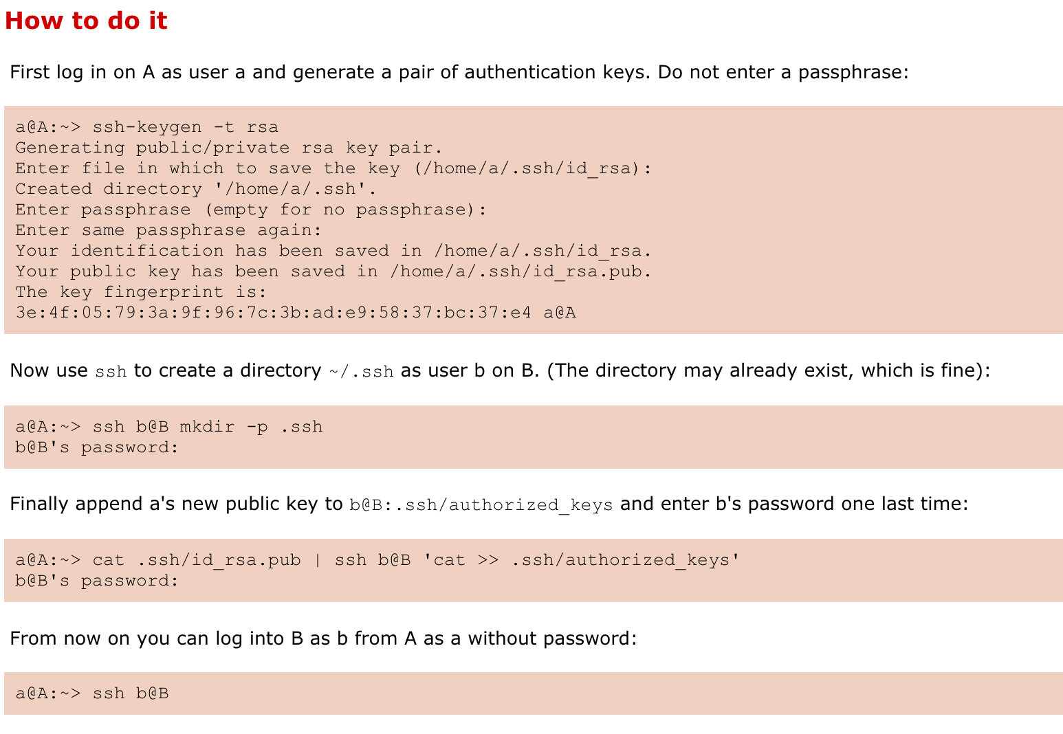
ssh without a password!

